Slide 1
Working with GitHub

Slide 2
Open Account in GitHub
Register with company email ( must use bsm official email id)
Forward account name to me

Slide 3
Git Basic Knowledge
Git Introduction (https://www.atlassian.com/git/tutorials/setting-up-a-repository )
Simple Git Guide (http://rogerdudler.github.io/git-guide/)
Git Document (http://git-scm.com/book/en/v2/Getting-Started-Git-Basics )

Slide 4
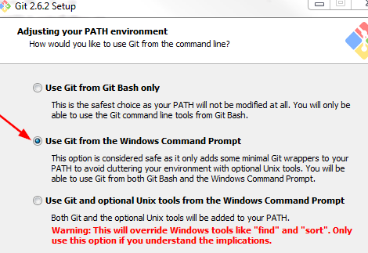
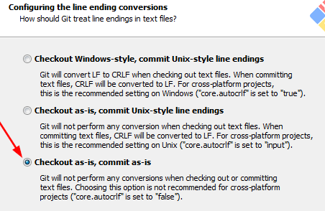
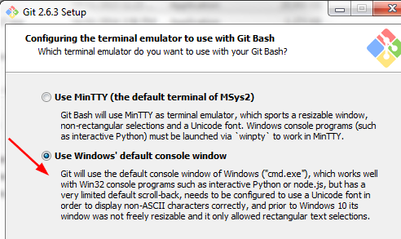
Install Git for Windows
Windows Setup
Download Git for Windows (https://git-for-windows.github.io/) and TortoiseGit
Install “Git for Windows”
Choose to install as “Administrator” ( so it will be installed under “Program File” folder, otherwise Git will be installed under your account )
During the installation, please choose following option

Slide 5
Verify installation
Open “Command Prompt”
Type “git –version” to check Git path is configured
Install TortoiseGit

Slide 6
Install Git for Linux
Linux Installation
sudo yum install git-all (Fedora)
sudo apt-get install git-all ( Debian based Linux)

Slide 7
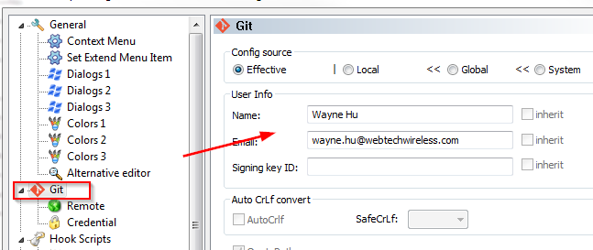
Git Setup
Assign name and email
git config --global user.name “Wayne Hu"
git config –-global user.email wayne.hu@webtechwireless.com

Slide 8
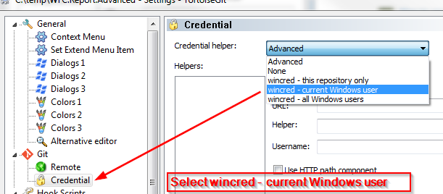
Remember password

Slide 9
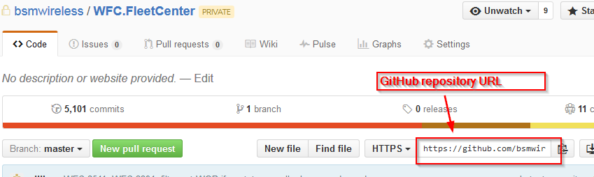
Checkout Project from GitHub
Checkout existing repository from GitHub
cd <your working directory>
git clone https://github.com/bsmwireless/<RepositoryName>.git
Cloning into 'WFC.Report.Advanced'...
Username for 'https://github.com': waynehu2008
Password for 'https://waynehu2008@github.com':
remote: Counting objects: 2173, done.
remote: Compressing objects: 100% (577/577), done.
d R0 ei
Receiving objects: 100% (2173/2173), 2.11 MiB | 1.68 MiB/s, done.
Resolving deltas: 100% (1537/1537), done.
Checking connectivity... done.

Slide 10
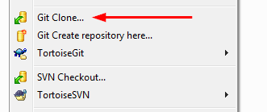
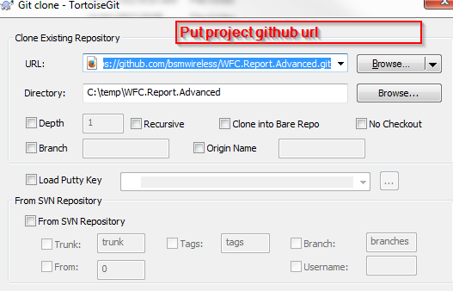
Checkout from GitHub ( with TortoiseGit )
Open context menu, select “Git Clone”
Enter your project GitHub URL, click OK to check out whole project

Slide 11
Commit Changes (local repo)
Check status first
Add files to staging area ( even this is a tracked file)
Commit to local repository
git status
On branch master
Your branch is up-to-date with 'origin/master'.
Untracked files:
(use "git add <file>..." to include in what will be committed)
../../../.flattened-pom.xml
../../../RESTApiInstallerLibs/
../../../rest_api_mq/.flattened-pom.xml
../../../rest_api_mq/target/
junit/
results.html
nothing added to commit but untracked files present (use "git add" to track)
git add <filename>
git commit –m “comments for the commit”

Slide 12
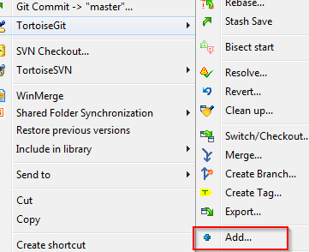
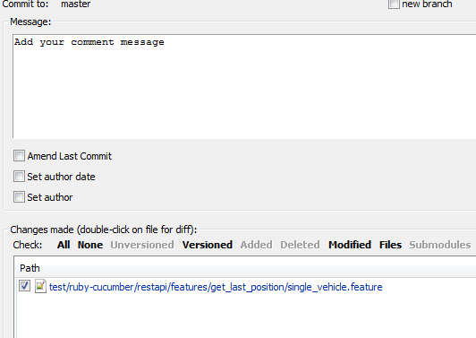
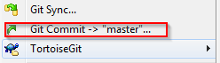
Select Git Add first
Then Git Commit -> “master”, select commit files and commit message. Click OK

Slide 13
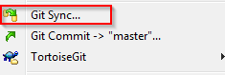
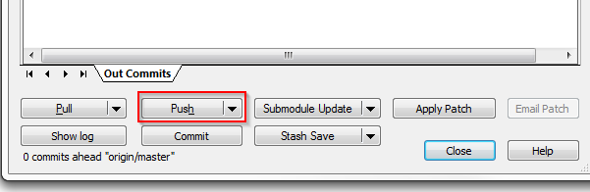
Push Changes to GitHub
Push local commits to GitHub
To understand what is ‘origin’, ‘master’, please read https://git-scm.com/book/en/v2/Git-Basics-Working-with-Remotes
For TortoiseGit, select “Git Sync”, click “Push” button
git remote add origin https://github.com/bsmwireless/WDC-Test.git
git push origin master

Slide 14
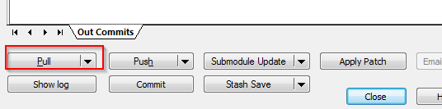
Pull Changes from GitHub
Pull changes from GitHub
git pull origin master

Slide 15
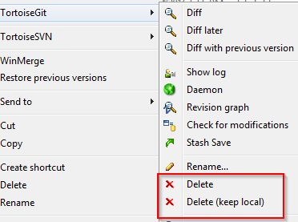
Remove File
Must use git command to Remove file
DO NOT delete directly in file system
Commit the change to repository
git rm <filename>
Or
git rm --cached <filename>
git commit –m “comments for the commit”

Slide 16
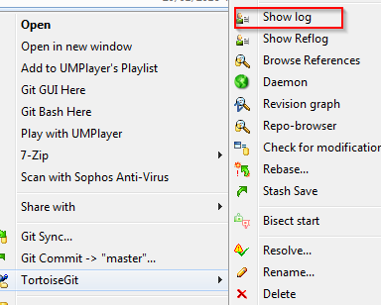
View Change History
View change history
git log –-pretty=oneline
git log –-stat (abbreviated stats for each commit )
git log -p -2 ( View changes on last 2 commit )

Slide 17
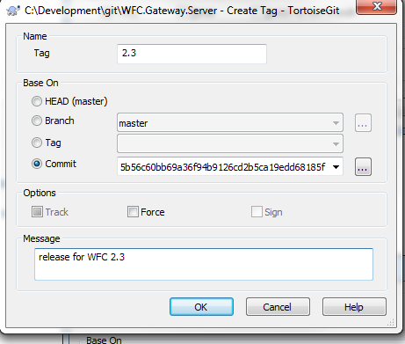
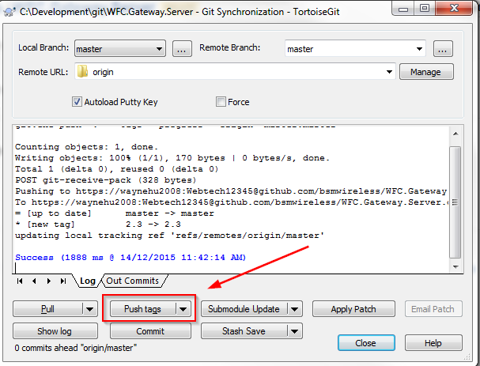
Tag the Release
For each release, we must create a tag in Git.
Using GitHub Web (http://stackoverflow.com/questions/18216991/create-a-tag-in-github-repository )
Using TotoriseGit
Totorise Git Menu -> Create Tag
Choose “Head” to create tag based on latest changes
Or
Select commit from change logs for the tag
TotoriseGit Menu -> Git Sync
Click “Push Tags” to upload changes to GitHub

Slide 18
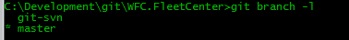
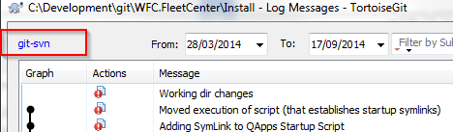
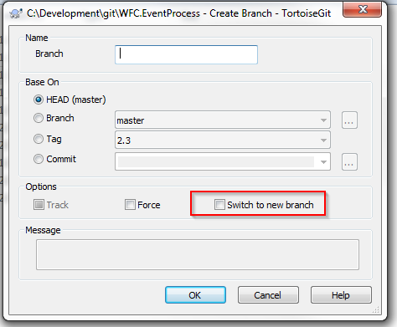
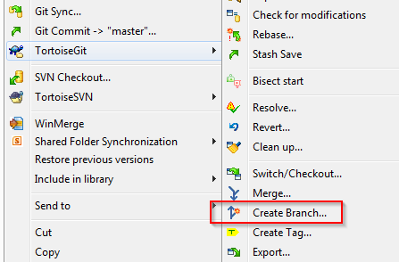
How to branch
Check which branch you are working ( which has * indicator )
Create(and switch) to new branch from an existing branch head
Command line
TortoiseGit
git branch <new_branch> <existing_branch>
git checkout –b <new_branch> <existing_branch>

Slide 19
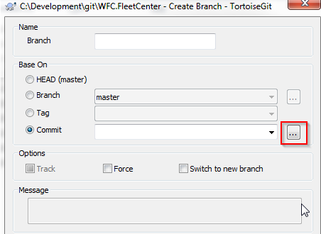
Create branch from specific commit
Command line
TortoiseGit
Create branch from tag
Command line
TortoiseGit
git branch <new_branch> a9c146a09505837ec03b
git branch <new_branch> <tag_name>

Slide 20
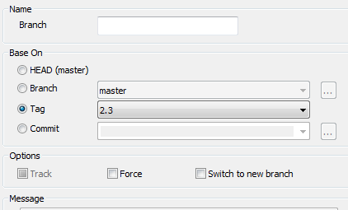
TortoiseGit

Slide 21
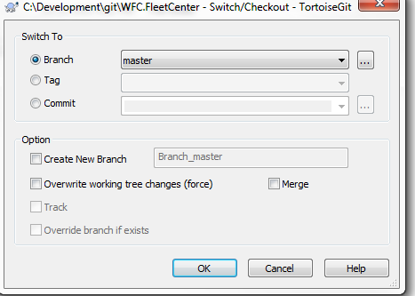
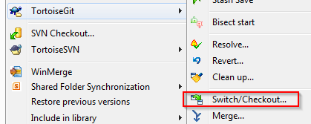
Switch branch
A clean switch
No uncommitted changes on working copy. Git will switch your workspace to specified branch
Local changes will be kept if both branch on the changed file has same history commit
Discard local changes on working copy
All untracked files will be kept in workspace after branch switch
The local changes on tracked files (event staged files) will be discarded
git checkout <branch_name>
git checkout -f <branch_name>

Slide 22
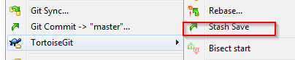
Save local changes and apply back
All untracked files will be kept
The command saves your local modifications away and reverts the working directory to match the HEAD commit.
git stash save “stash summary”
git checkout <branch_name_A>
... Complete the work on branchA and revert back master
git checkout master
git stash apply

Slide 23
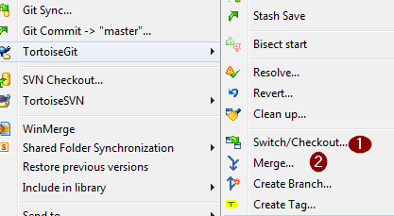
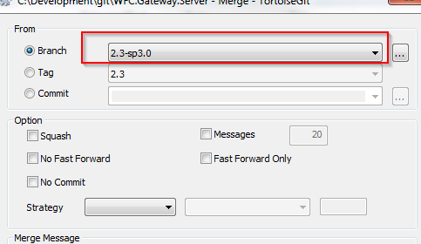
Merge changes from branch
Merge changes of one branch to another ( make sure no uncommitted changes)
Command line
TortoiseGit ( checkout, merge )
git checkout master
git merge –-no-ff <branch_name>

Slide 24
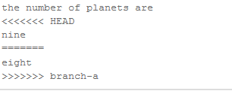
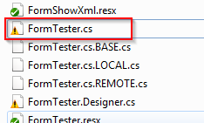
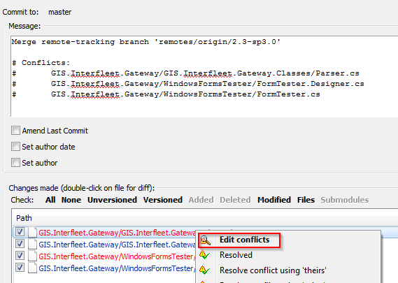
Resolve Conflicts ( Torgoise Git)
Conflict indicator
Manually edit the conflict file OR through some tools
Once done. Select “Conflict Resolved” in torgoisegit
Commit the changes to Git

Slide 25
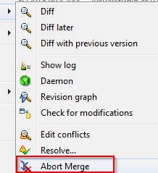
Undo Merge
Abort the current conflict resolution process: return to the state before you started the merge
Undo merge
git merge –-abort
git reset --hard

Slide 26
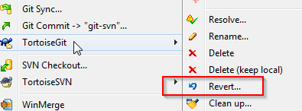
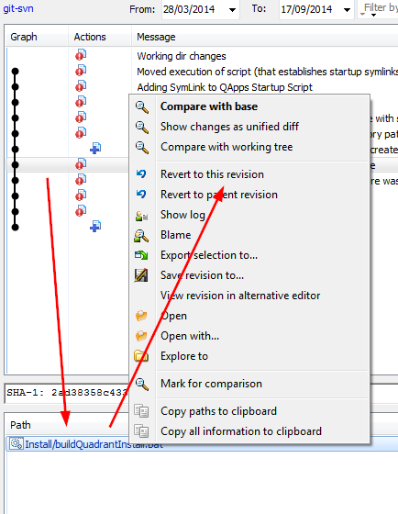
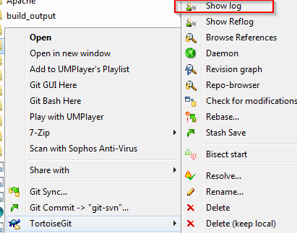
Undo changes
Discard changes on unstaged files
Back to historical commit
git checkout <file name>
git checkout <commit > <file name>

Slide 27
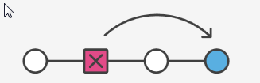
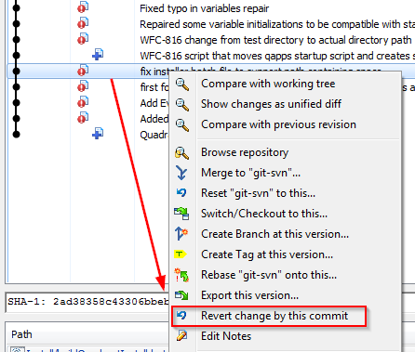
Undo a commit
Undo is not remove commit from history. It “undo changes” and append a new commit with resulting contents
Remove staging files ( but still keep the changes )
git revert <commit >
git reset <file >

Slide 28
Force sync with remote
Force local repository to match with remote
In order to clean up some messy in local repository and make the local repository exactly match the remote tracking branch (http://stackoverflow.com/questions/1125968/force-git-to-overwrite-local-files-on-pull)
git fetch –all
git reset --hard origin/<branch name>

Slide 29
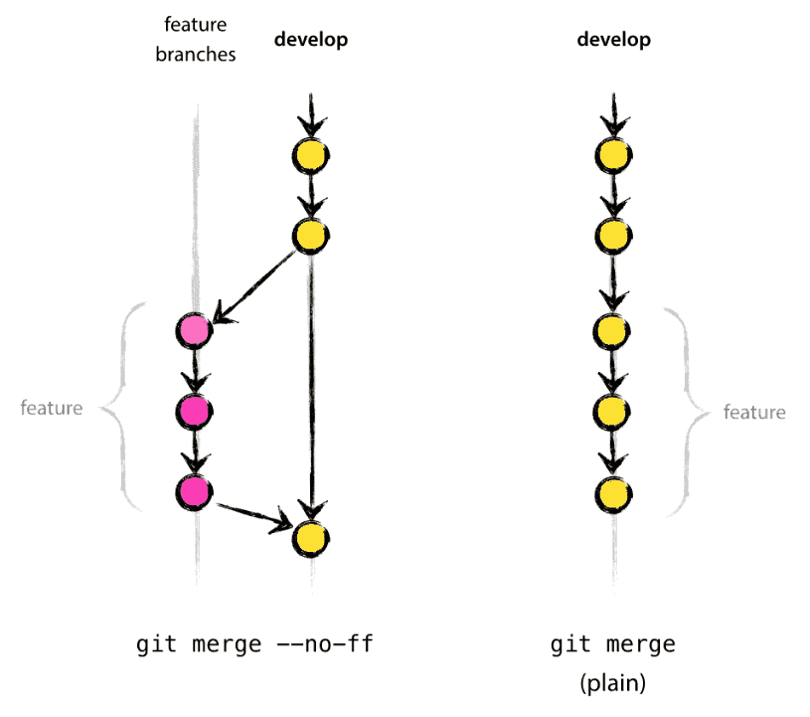
Merge with -- no-ff
When merge branch, add “—no-ff” flag
The --no-ff flag causes the merge to always create a new commit object, even if the merge could be performed with a fast-forward. This avoids losing information about the historical existence of a feature branch and groups together all commits that together added the feature. Compare:
In the latter case, it is impossible to see from the Git history which of the commit objects together have implemented a feature—you would have to manually read all the log messages. Reverting a whole feature (i.e. a group of commits), is a true headache in the latter situation, whereas it is easily done if the --no-ff flag was used.

Slide 30
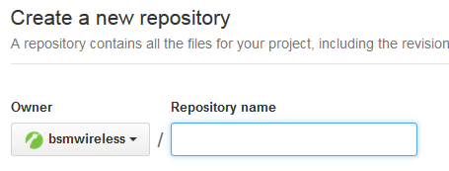
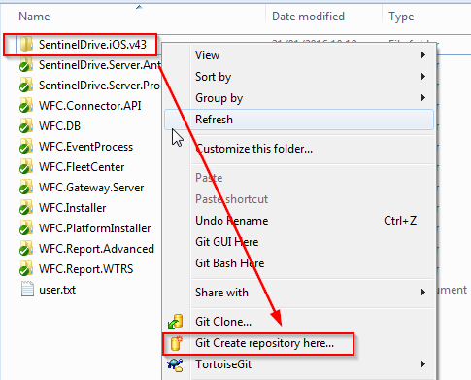
Create New Repository in GitHub
Login GiHub then create repository in GitHub
Create git repository in your local machine ( you need to have a folder that contains all your files of the project)
Cd <your working folder>
git init

Slide 31
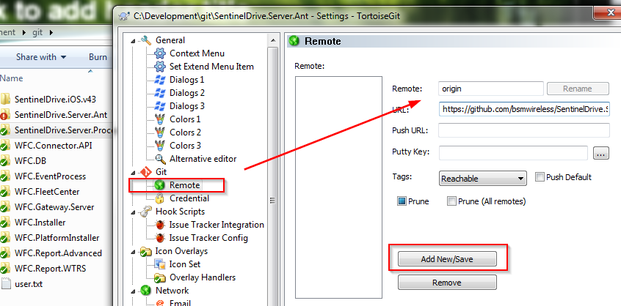
Configure remote URL
For TortoiseGit, select the directory, open context menu, select “Settings”, then add “origin” remote with your GitHub URL
git remote add origin <Git Hub repository URL>
Example
git remote add origin https://github.com/bsmwireless/SentinelDrive.Server.Processor.git

Slide 32
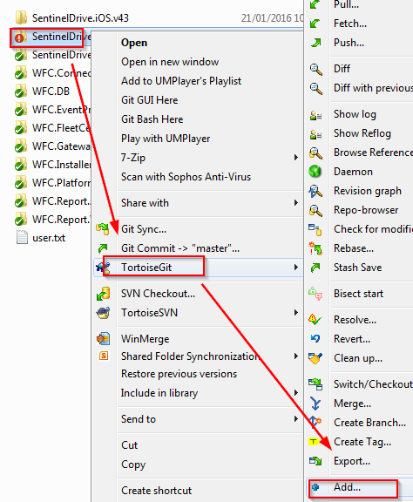
Add files to git ( below commands add all file and subdirectories )
git add .

Slide 33
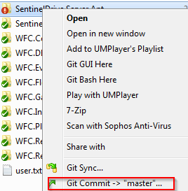
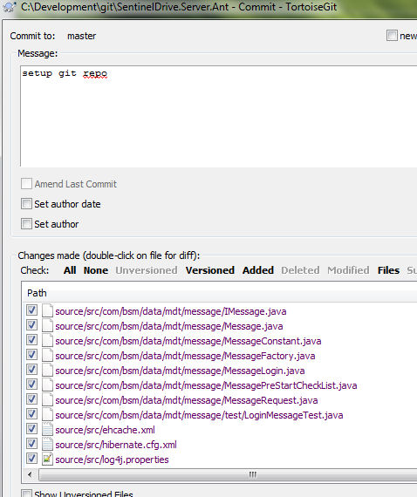
Commit to local repository
git commit -m “git repo setup”

Slide 34
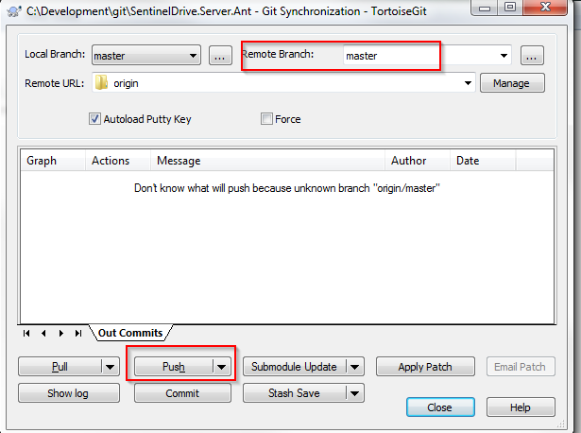
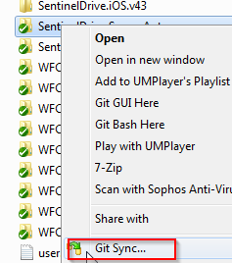
Upload to GitHub
git push origin master

Slide 35
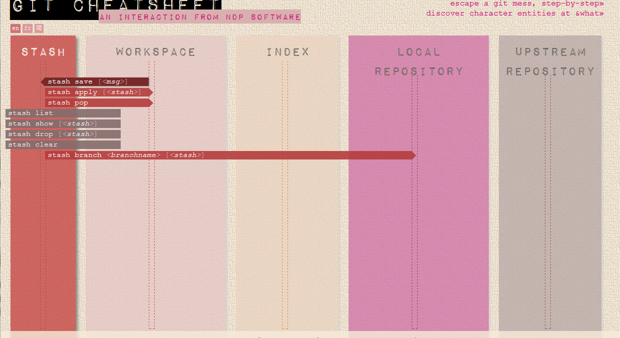
Git CheatSheet
Interactive Git cheatsheet http://www.ndpsoftware.com/git-cheatsheet.html

Slide 36
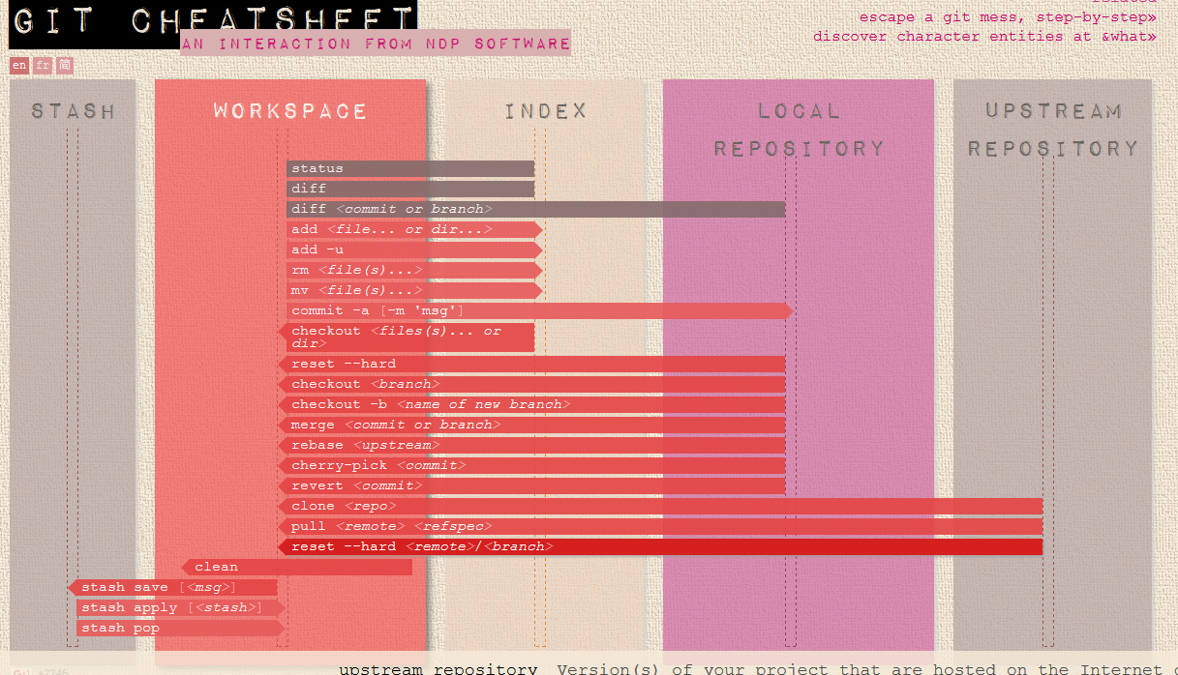

Slide 37
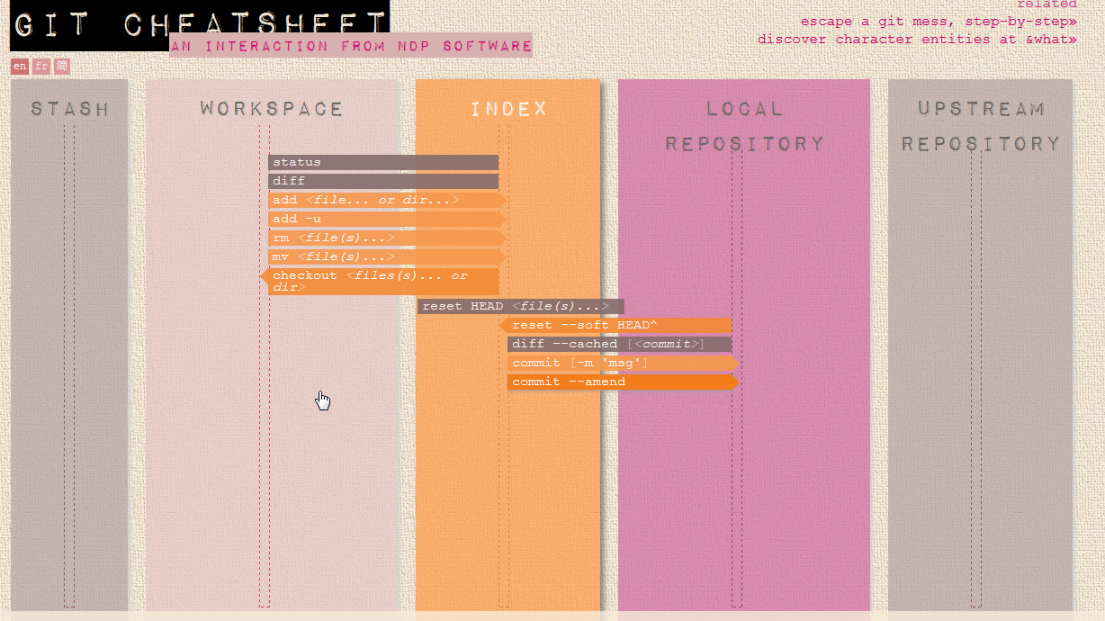

Slide 38


Slide 39


